Slide 1
Embedded Class 9
Pin Driver

Slide 2

Agenda
Requirements for Driver
Implementation Detail
Discussions

Slide 3

Requirements
Correct Code
This is always a requirement
Understandable Code
This is always a requirement
Abstraction
abstract pin such that pin assignments can change
pin requires no changes in code.
Fast code
Ideally one or two assembly instructions to set GPIO high/low
Low memory usage
Should use minimal RAM
Minimal Dependencies
Should use minimal libraries/code as it is part of our foundation’

Slide 4

Attributes
What information do we need for a pin?
Port and pin number
Which mux it uses
Which peripheral uses it.
State for sleeping
Others?

Slide 5

Structure
Structs (aka structures)
Group of related information or attributes together
typedef struct {
uint32_t pinNum;
void *ptrPeriheral;
pinMuxType_t type;
uint32_t param; //pad pin waveform
pinMuxType_t sleepType;
}pin_t;

Slide 6
Typedef
typedef enum {
PERPIHERAL_GPIO_INPUT,
PERPIHERAL_GPIO_INPUT_PULLED_HIGH,
PERPIHERAL_GPIO_INPUT_PULLED_LOW,
PERPIHERAL_GPIO_OUTPUT_LOW,
PERPIHERAL_GPIO_OUTPUT_HIGH,
PERPIHERAL_EIC,
PERPIHERAL_EIC_PULLED_HIGH,
PERPIHERAL_EIC_PULLED_LOW,
PERPIHERAL_REF,
PERPIHERAL_ADC,
PERPIHERAL_AC,
PERPIHERAL_PTC,
PERPIHERAL_SERCOM_INPUT,
PERPIHERAL_SERCOM_OUTPUT,
PERPIHERAL_SERCOM_ALT_INPUT,
PERPIHERAL_SERCOM_ALT_OUTPUT,
PERPIHERAL_TC_E_OUTPUT,
PERPIHERAL_TC_E_INPUT,
PERPIHERAL_TC_F_OUTPUT,
PERPIHERAL_TC_F_INPUT,
PERPIHERAL_COM,
PERPIHERAL_AC_GCL,
}pinMuxType_t;
Create a new data type in C/C++
typedef struct {
uint32_t pinNum;
void *ptrPeriheral;
pinMuxType_t type;
uint32_t param; //pad pin waveform
pinMuxType_t sleepType;
}pin_t;

Slide 7
Declaring a ‘Pin_t’
typedef struct {
uint32_t pinNum;
void *ptrPeriheral;
pinMuxType_t type;
uint32_t param; //pad pin waveform
pinMuxType_t sleepType;
}pin_t;
////Human/Machine interface connections for UART
#define PIN_HMI_TX((const pin_t){PIN_PA24, SERCOM3, PERPIHERAL_SERCOM_OUTPUT, PAD_2, PERPIHERAL_GPIO_INPUT_PULLED_LOW})
#define PIN_HMI_RX((const pin_t){PIN_PA25, SERCOM3, PERPIHERAL_SERCOM_INPUT, PAD_3, PERPIHERAL_GPIO_INPUT_PULLED_LOW})
Const forces the structure to be in Flash memory only
Means it can not change during execution
Means it is not copied to SRAM either.

Slide 8
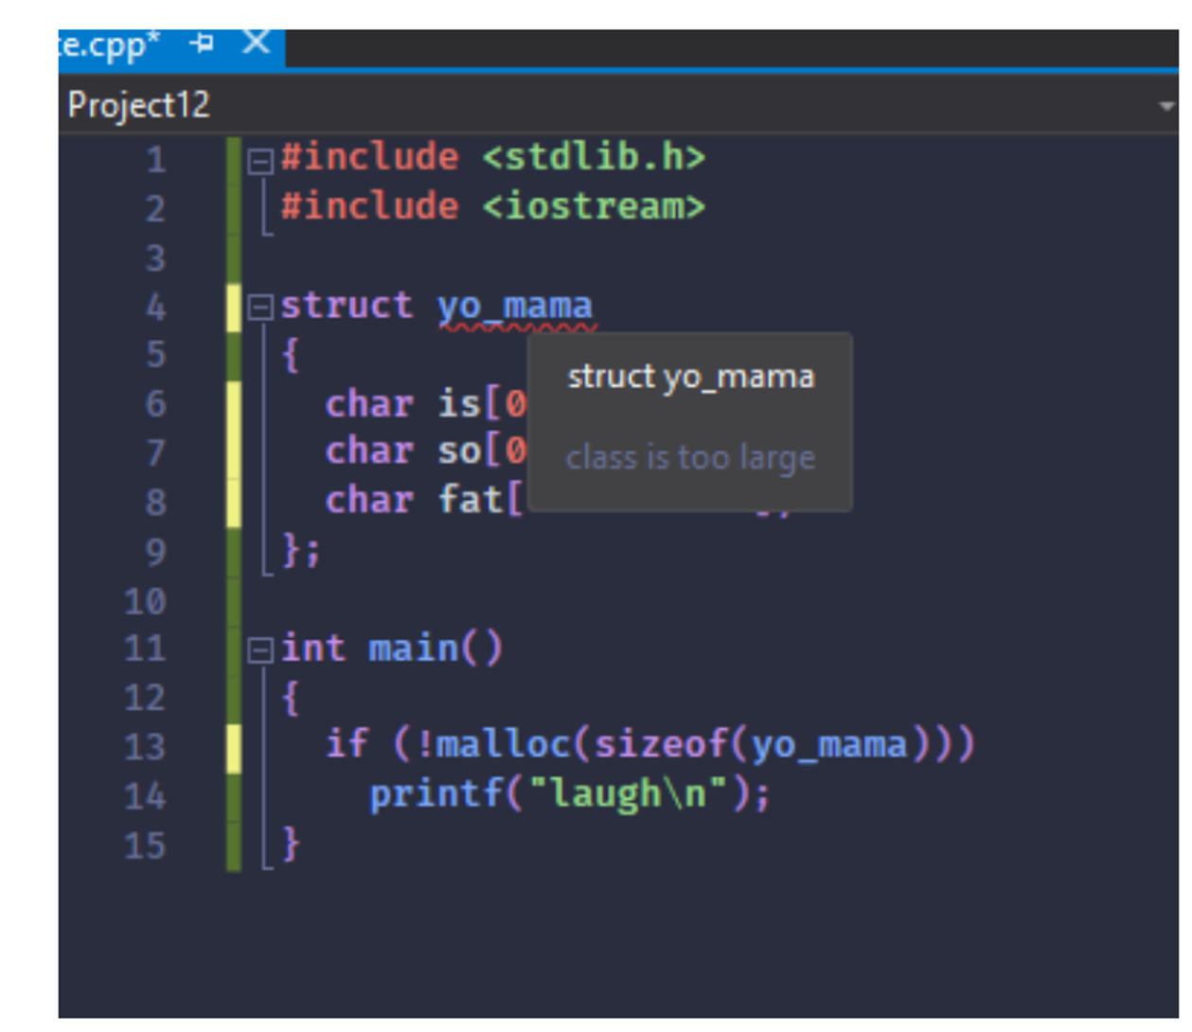
Using a Pin_t
Configure the pin
PinConfig(PIN_HMI_TX)
Reading Pin
PinRead(PIN_HMI_TX)
Writing Pin
PinHigh(PIN_HMI_TX)
PinLow(PIN_HMI_TX)

Slide 9
Pin Abstraction for UART Driver
bool UartInit(uint32_t baud, pin_t tx, pin_t rx);
The pins are now parameters to the init function.
The correct SERCOM perpherial is part of the pins
We now can change pin assignments and not the code.

Slide 10


To The Code

Slide 11

Object Oriented Design
The pin struct is like a class (object)
Object oriented design can be done in C
Inheritance
Polymorphism
Abstraction
Encapsulation
Which of the above is provide with Pin_t?

Slide 12
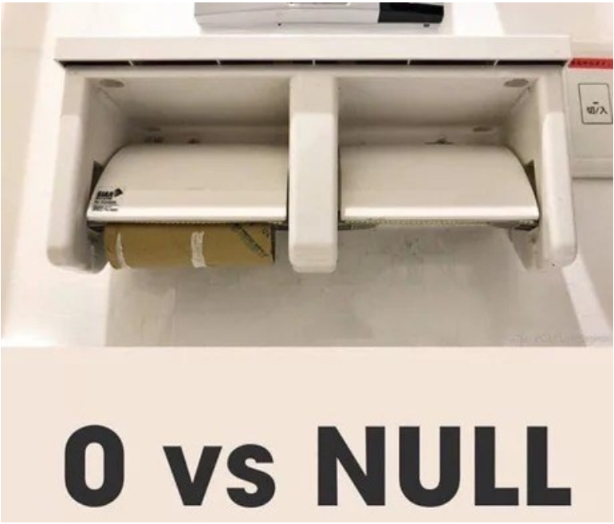
Class verse Struct
What if we made the Pin a class?
PIN_HMI_TX.config();
PIN_HMI_TX.high();
PIN_HMI_TX.low();
PIN_HMI_TX.read();
Is it cleaner?
MEH?
Would/Could UART driver be cleaner as a Class?
If so how?

Slide 13
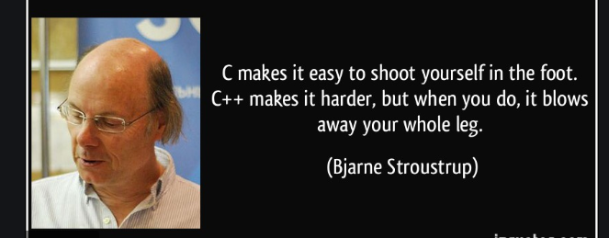
Object Oriented Design
Does not require C++
But why not use C++?
Where would C++ be better to use than C in embedded?

